Slide 1

AmbitionBox Top 500 Companies
Web Scraping & Data Analytics

Slide 2
ABOUT ME
Madishetti Rakshitha
B.Tech Graduate | 2026
Interested in Data Analytics & Data Science
Skills: Python • Web Scraping • Regex • Pandas • Excel
Project: AmbitionBox Top 500 Companies — Web Scraping & Data Analytics
Linkedin: https://www.linkedin.com/in/madishetti-rakshitha-b1a332343
Github: https://github.com/Rakshitha152003

Slide 3
TABLE OF CONTENTS
• Project Overview.
• Business Scenario.
• Business Objectives.
• Dataset & Data Structure.
• Data Cleaning & Validation.
• Exploratory Data Analysis.
• Dashboard & Visualizations.
• Key Findings.
• Business Recommendations.
• Conclusion.

Slide 4
PROJECT OVERVIEW
• Collected company information from AmbitionBox using Python.
• Used Regex to extract ratings and review information from raw web content.
• Cleaned and structured the scraped data using Pandas.
• Analysed ratings, reviews, industries and locations.
• Built an Excel Company Intelligence Dashboard for business-focused insights.

Slide 5
BUSINESS SCENARIO
• Employee ratings and reviews provide a view of workplace perception.
• Companies can use employee feedback to identify areas for improvement.
• Industry comparisons help understand differences across business sectors.
• Location analysis highlights where companies are concentrated.
• The project converts web information into structured business insights.

Slide 6
BUSINESS OBJECTIVES
• Collect company information through web scraping.
• Extract relevant fields using Regex.
• Clean, transform and validate the scraped dataset.
• Analyse ratings, reviews, industries and locations.
• Create meaningful visualizations and an Excel dashboard.
• Derive actionable business insights and recommendations.

Slide 7
DATASET & DATA STRUCTURE
495
Final Companies
6
Data Fields
6.63M
Total Reviews
13,393
Average Reviews
Core Fields
Company Name • Company Rating • Reviews • Industry • Location • Raw Card Text
Data Journey
Web Pages → Raw Data → Clean Dataset → Analysis

Slide 8
DATA CLEANING & VALIDATION
• Duplicate company records were identified and removed.
• Ratings and review counts were converted into numeric values.
• K, L and M review units were converted into actual numbers.
• Missing and inconsistent categorical values were standardized.
• The final dataset was validated for duplicates, missing values and data types.
• 495 clean records were prepared for final analysis.

Slide 9
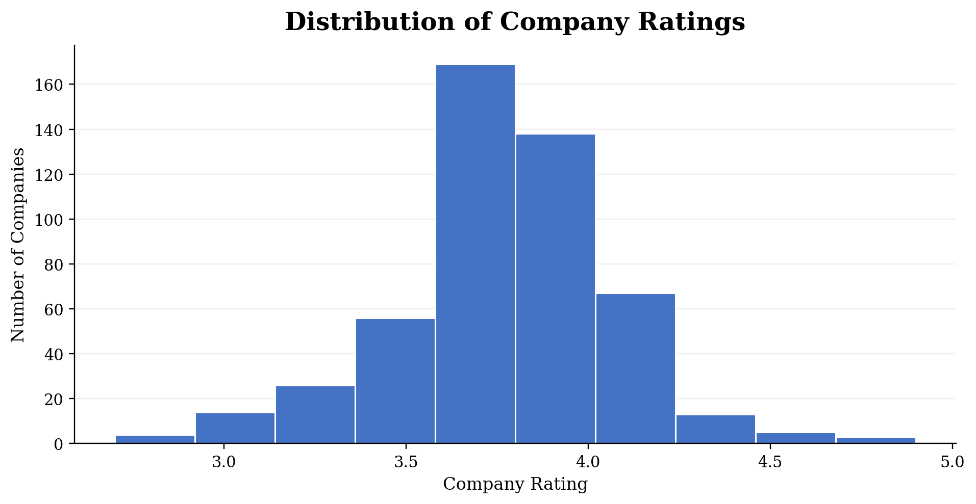
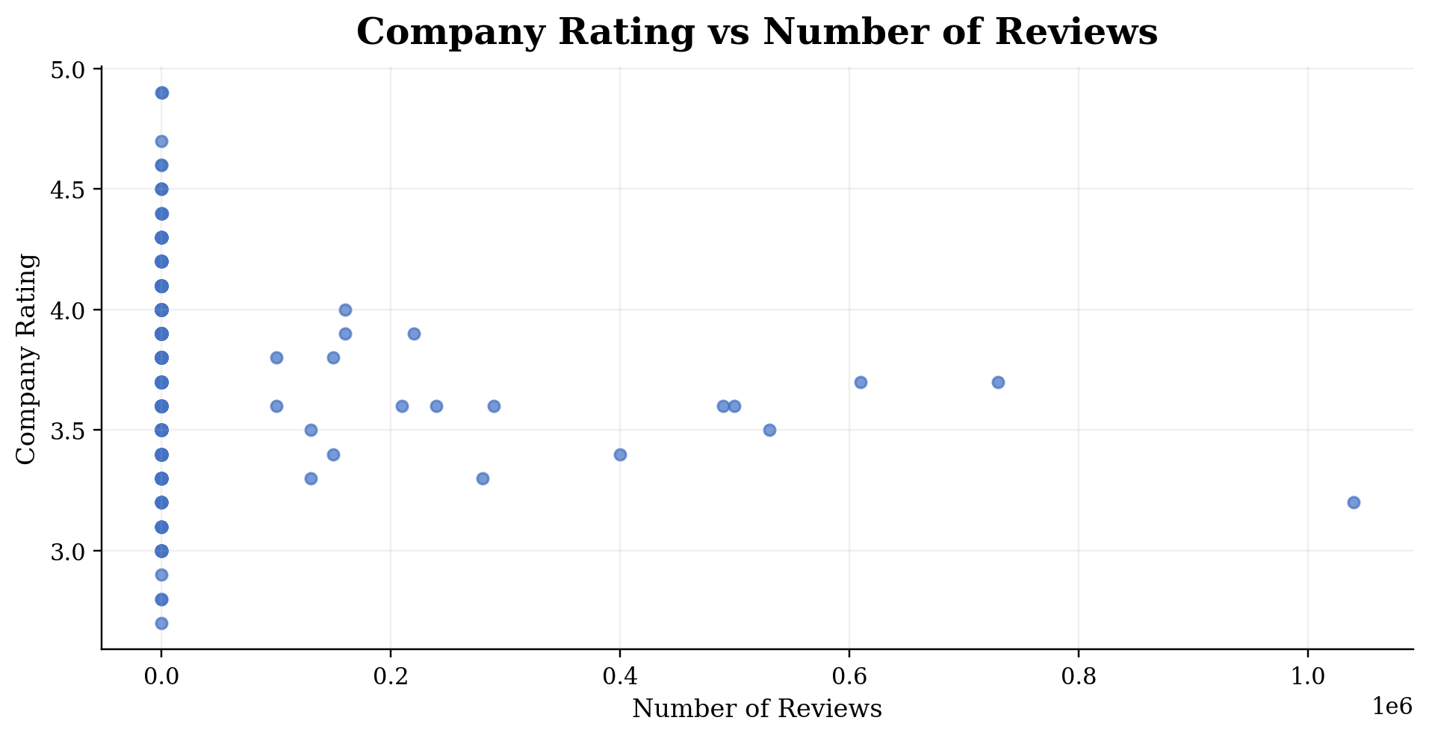
EXPLORATORY DATA ANALYSIS

Slide 10
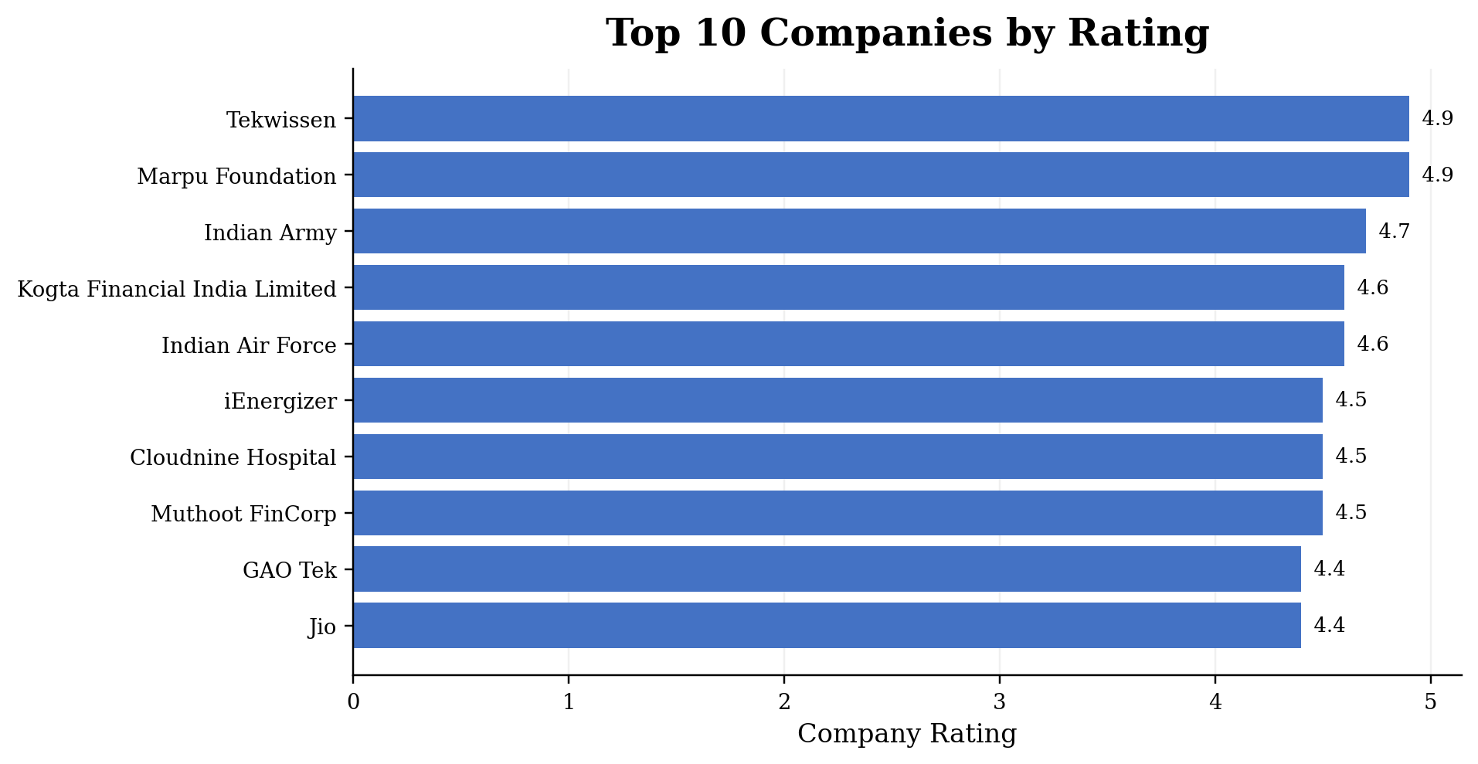
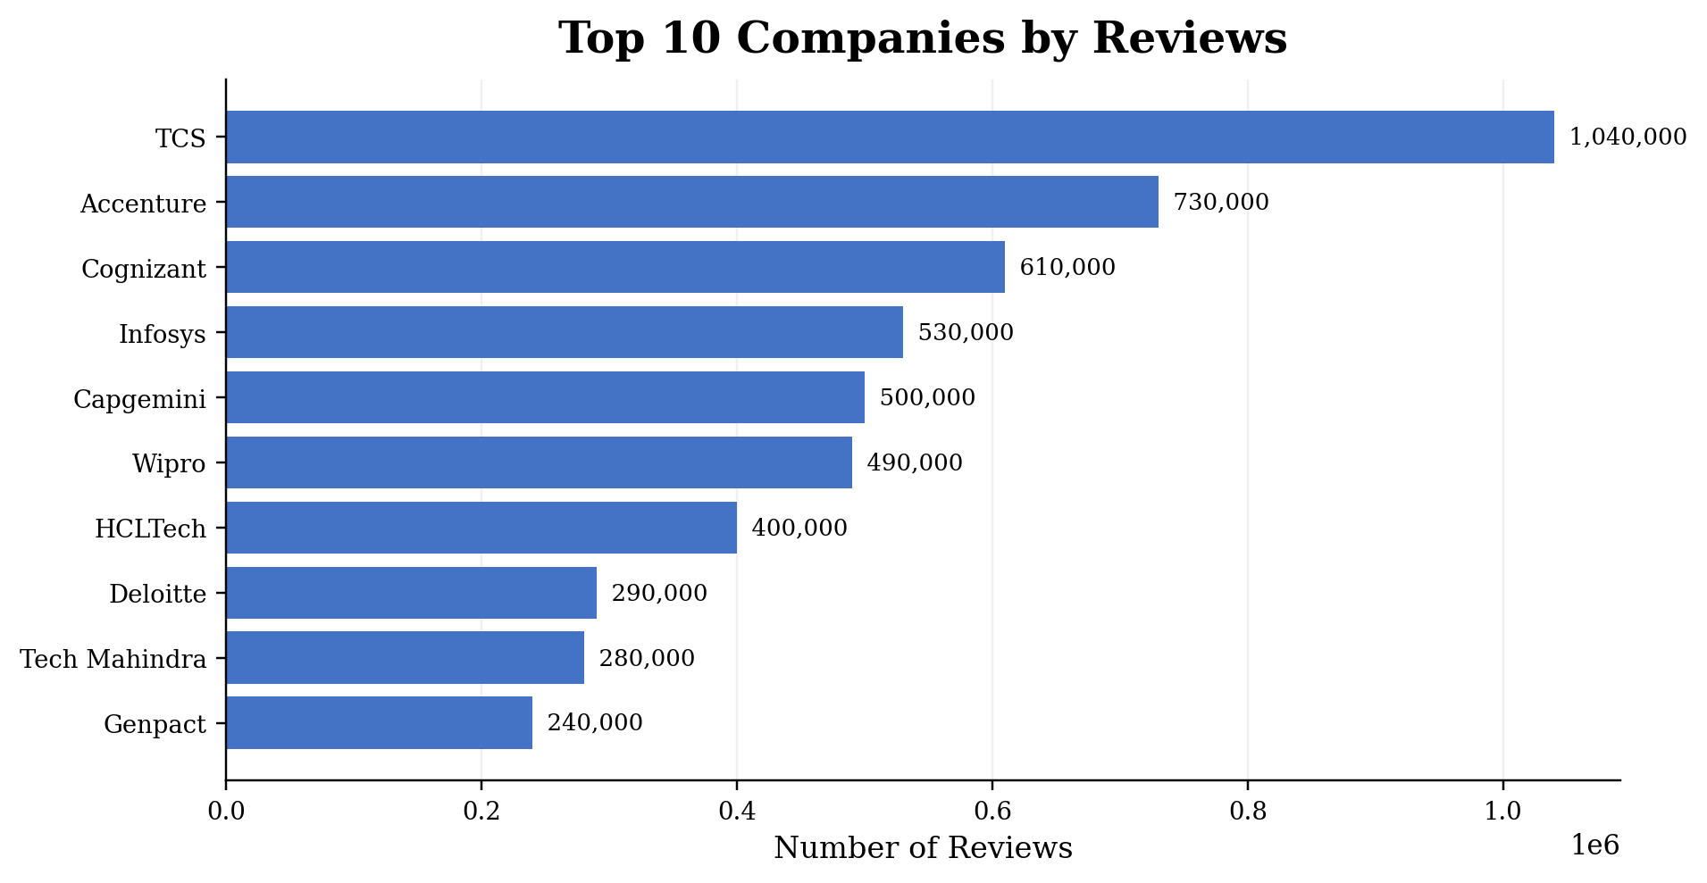
COMPANY RATING & REVIEW ANALYSIS

Slide 11
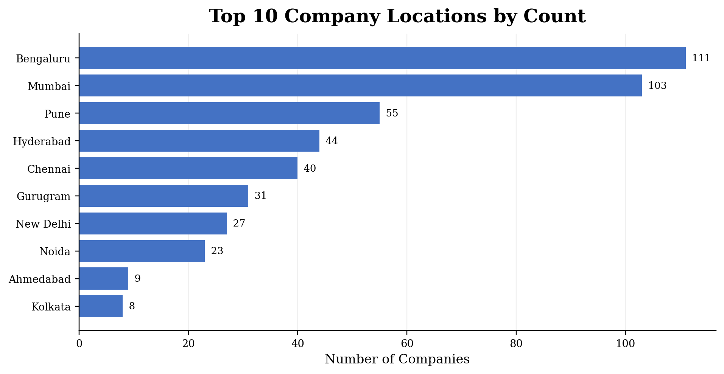
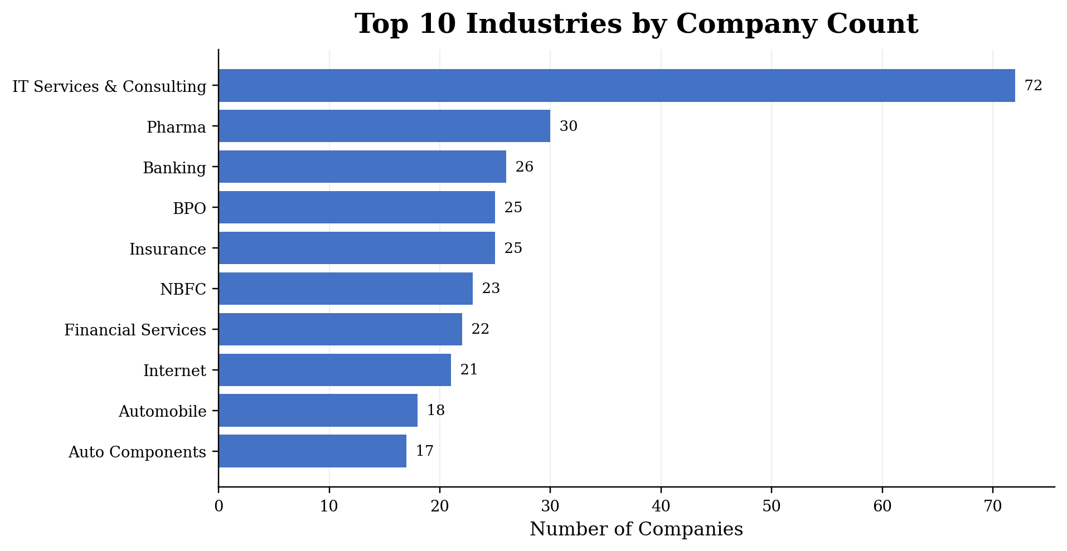
INDUSTRY & LOCATION ANALYSIS

Slide 12
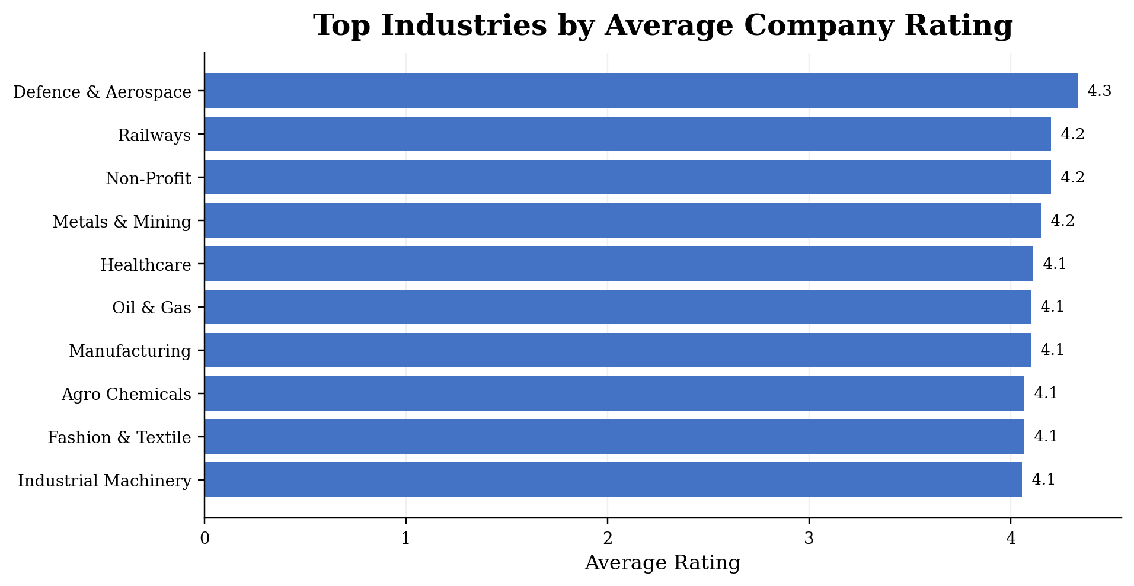
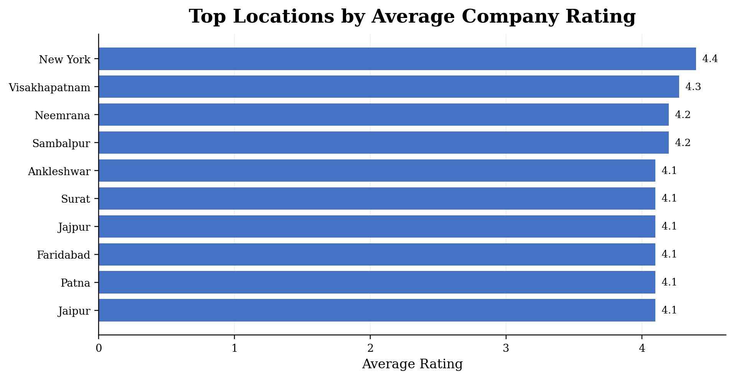
RATING BENCHMARKING

Slide 13
COMPANY INTELLIGENCE DASHBOARD
495
Total Companies
3.78
Average Rating
6,629,388
Total Reviews
13,393
Average Reviews

Slide 14
OVERALL KEY FINDINGS
• The final dataset contains 495 validated companies.
• The overall average company rating is 3.78.
• The dataset contains approximately 6.63 million employee reviews.
• Review volume varies substantially across companies.
• Industry and location analysis reveals clear differences in company concentration and average ratings.

Slide 15
BUSINESS RECOMMENDATIONS
• Monitor employee ratings regularly to track workplace perception.
• Investigate recurring feedback patterns behind lower ratings.
• Use review volume as an indicator of the depth of available employee feedback.
• Benchmark company ratings against peers within the same industry.
• Use location-level comparisons to identify regional differences.
• Repeat the analysis periodically to support evidence-based workplace decisions.

Slide 16
CONCLUSION
• The project demonstrates an end-to-end web scraping and data analytics workflow.
• AmbitionBox data was collected, extracted using Regex, cleaned and validated.
• EDA was used to examine ratings, reviews, industries and locations.
• The Excel dashboard converts the analysis into a clear company intelligence view.
• The final output shows how web data can be transformed into business insights.
Web Data → Structured Data → Business Insights

Slide 17

THANK YOU

